Slide 1

CAPSTONE PROJECT RESUME CATEGORY PREDICTION
Presented By
Student Name: Vallabh Vinayak sangar
College Name:: DKTE Society’s Textile and Engineering Institute, Ichalkaranji
Department: ARTIFICIAL INTELLIGENCE AND DATA SCIENCE ENGINEERING
Email ID: VALLABHSANGAR412@GMAIL.COM
AICTE Student ID: STU662f3fd556d471714372565

Slide 2
OUTLINE
Problem Statement (Should not include solution)
Proposed System/Solution
System Development Approach (Technology Used)
Algorithm & Deployment
Result (Output Image)
Conclusion
Future Scope
References

Slide 3
Problem Statement
Manual resume screening is time-consuming and error-prone. Recruiters often struggle to categorize resumes accurately due to varying formats and content, especially with large application volumes.

Slide 4
Proposed Solution
The proposed system aims to automate the classification of resumes into predefined job categories using machine learning and natural language processing (NLP). This addresses the challenge of manual filtering by providing fast, consistent, and scalable resume screening.
Deployment:
Developed an interactive web app using Streamlit, allowing users to:
Upload resume files (PDF/DOCX/TXT)
View extracted resume content
Receive the predicted job category instantly
Backend models (clf.pkl, tfidf.pkl, and encoder.pkl) are pre-trained and loaded using pickle.
Data Collection:
Utilized a labeled resume dataset containing resumes categorized into fields like Data Science, HR, DevOps, etc.
Accepted resumes in various formats including PDF, DOCX, and TXT for real-world applicability.
Data Preprocessing:
Extracted text using libraries: PyPDF2, python-docx, and encoding-handled text reads.
Cleaned resumes to remove URLs, special characters, emojis, stopwords, and non-ASCII characters using regex.
Applied lemmatization and case normalization to improve text consistency.
Machine Learning Algorithm:
Used TF-IDF Vectorizer to transform the resume text into numerical feature vectors.
Trained a Support Vector Machine (SVM) classifier for multi-class classification.
Encoded the output labels using LabelEncoder for structured prediction.
Evaluation:
Model perormance evaluated using accuracy score and classification report during training.
Real-time predictions tested with unseen resume samples.
Future versions may include cross-validation, multi-label classification, or model ensembles.
a

Slide 5
System Approach
The system uses:
Python, Streamlit (for the web app)
scikit-learn (for ML)
TF-IDF for text vectorization
SVM for classification
PyPDF2, python-docx (for text extraction)

Slide 6
Algorithm & Deployment
Algorithm Used: Support Vector Machine (SVM) for classifying resumes into categories like HR, Data Science, DevOps, etc.
Input Features: Cleaned resume text (PDF, DOCX, TXT) transformed using TF-IDF Vectorizer.
Training: SVM model trained on labeled resume dataset.
TF-IDF and LabelEncoder used for text and label preprocessing. Model saved as clf.pkl for deployment.
Prediction Process: Resume → Text Extraction → Cleaning → TF-IDF → SVM → Category Prediction.
Deployment: Deployed using Streamlit. Users upload resumes and receive real-time category predictions via a web app.

Slide 7
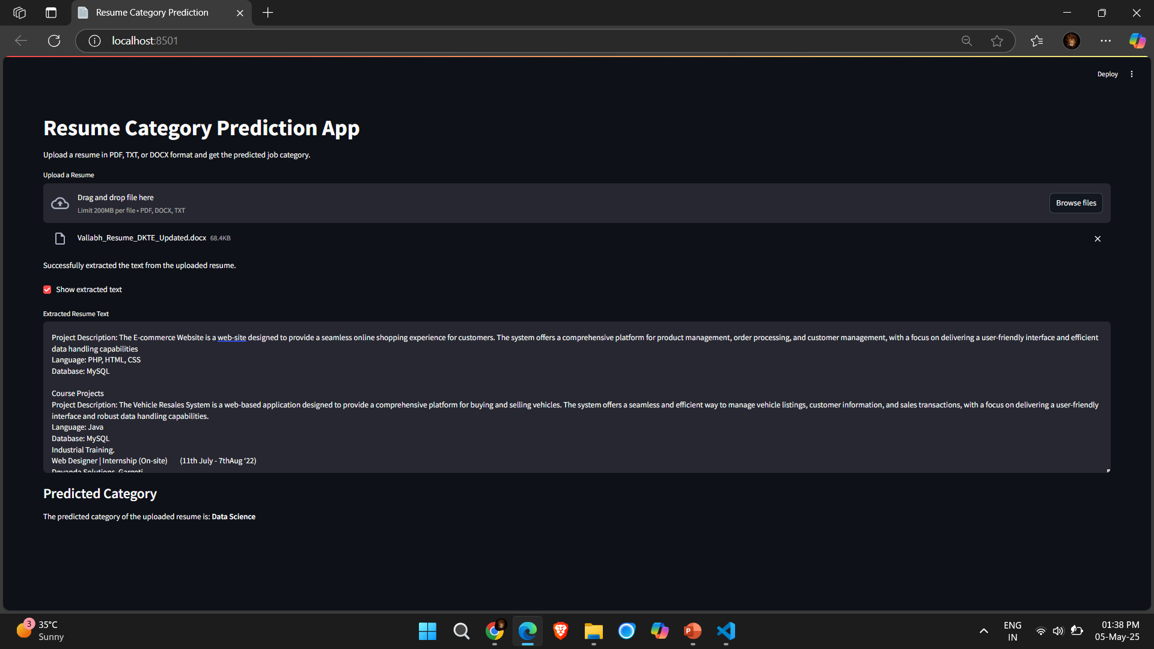
Result

Slide 8
Conclusion
The resume category prediction system leverages machine learning and NLP techniques to automate resume classification into predefined job categories. By implementing robust data preprocessing, training an accurate classifier, and deploying a user-friendly web application, the system significantly reduces manual effort and enhances hiring efficiency. With promising evaluation results, future improvements may include multi-label classification, cross-validation techniques, and ensemble models to further refine accuracy and scalability. This project presents a practical and scalable solution to streamline the resume screening process in recruitment.

Slide 9
Future scope
Enhanced Accuracy with Advanced Models: Implement deep learning techniques like transformers and ensemble methods to improve classification precision.
Multi-Label Classification: Enable resumes to be tagged with multiple relevant job categories, offering more nuanced classification.
Cross-Domain Learning: Train the model using diverse datasets across industries to enhance adaptability.
Integration with Applicant Tracking Systems (ATS): Seamlessly embed the classifier into recruitment platforms for automated screening.
Real-Time Recommendations: Develop a feature that suggests job roles based on extracted resume content.
Scalability and Cloud Deployment: Utilize cloud computing for handling large-scale resume data efficiently.
Bias Mitigation and Fairness: Incorporate fairness-aware AI techniques to ensure unbiased categorization across demographic factors.

Slide 10
References
GitHub Link: https://github.com/vallabhsangar12/ResumeCategoryPrediction.git

Slide 11
Thank you

